Slide 1

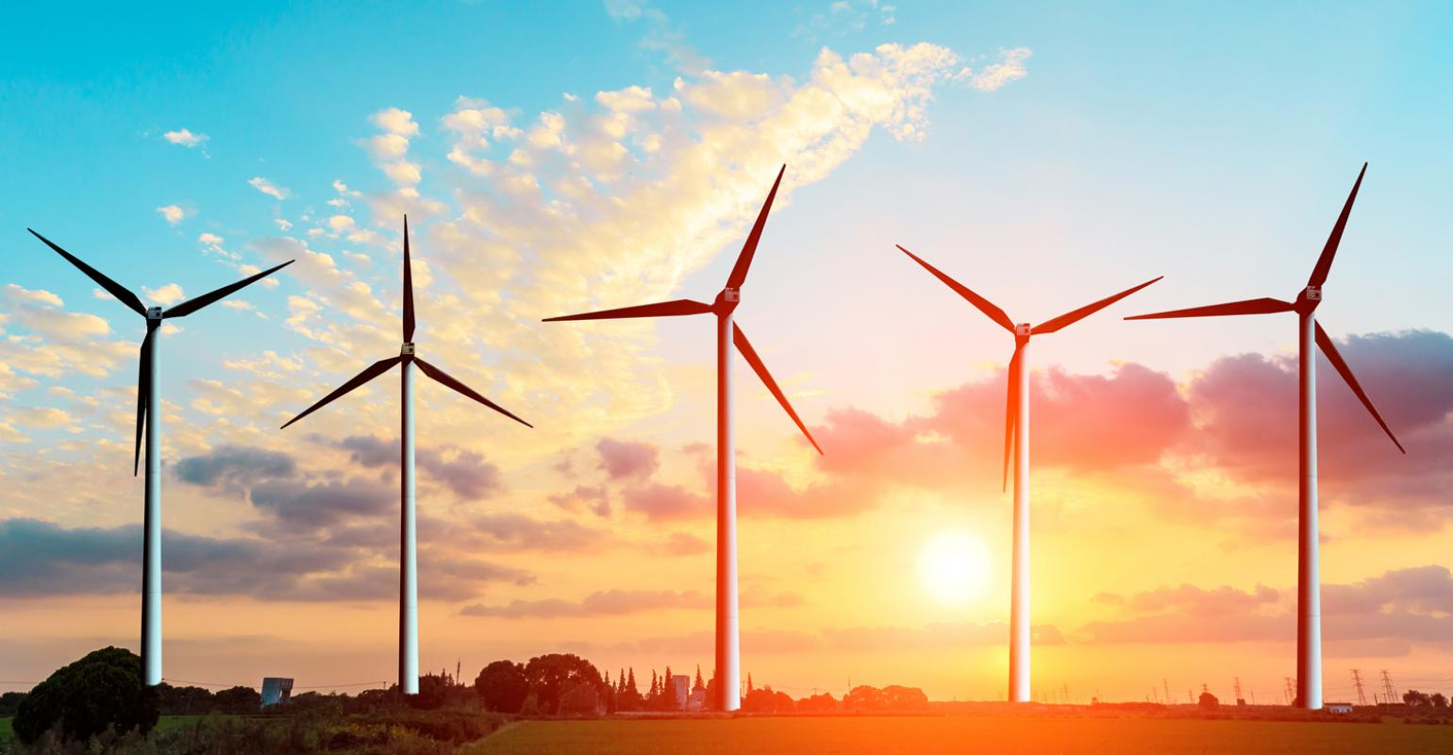
Utilizing unused renewable energy

Slide 2
Problem
Wind power plant power production fluctuates and is weather dependent
3.23 billion kilowatthours were restricted in the first quarter of 2019
Is it possible to store or use this restricted energy?

Slide 3
Introduction
1. Vehicle to grid
2. Hydrogen as an energy storage system
3. Pumped storage hydropower
4. Power-to-Gas
5. Batteries

Slide 4
Vehicle to grid

Slide 5
Hydrogen as an energy storage system

Slide 6
Pumped storage hydropower

Slide 7
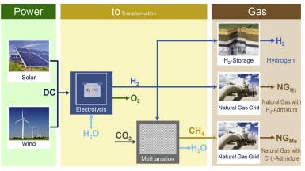
Power-to-Gas

Slide 8
Batteries

Slide 9
Comparision
 | Cost | Efficiency | Safety | Scalability | Technical feasibility
Vehicle to grid
Hydrogen
Pumped storage hydropower
Power-to-Gas | - - | + / - | + + | + + | +
Batteries

Slide 10
Conclusion

Slide 11
Recommendations

